Slide 1


Project Failure Diary &
Lessons Learned
Comprehensive Analysis of Bugs, Failures, and Strategic Architecture
Revision: c748621 to 68fde00 | August 2026

Slide 2

Technical Memory & Status Glossary
Resolved Root Causes
Controlled Risks
Root cause verified and fixed with corresponding regression tests and live evidence.
Risk controlled, although platform or architectural limitations still persist.
Legacy Evidence
Ongoing Research
Measurements valid for old revisions; no longer representative of current code state.
Performance or accuracy issues still under investigation; unresolved bottlenecks.
Source of Truth: realistic_project_creation_codex.md, Git History, and Locked Benchmark Reports.

Slide 3
Strategic Overview: The Gate Roadmap
Gate | Primary Architectural Failure | Outcome / Resolution
P0 | Ollama JSON grammar compilation failed due to Pydantic regex. | Adapter cleanup schema implemented; live smoke pass.
P1 | WSL I/O latency; Loader cardinality errors; anomaly misunderstanding. | Atomic build in Linux ext4; 20/20 validation achieved.
P3.1 | Mini-100 unique constraint violation; Weak index publication. | Benchmark hardening; holdout separation.
P5 | Laptop instability during full-GPU runs; 78.33% Olist accuracy. | Guarded runner; 6-layer profile; checkpoint UI.
P6.3 | Free-form query scope errors; Scalar correction mismatch. | Dimension-aware linking; Correction-on by default.

Slide 4

P0-P1: Infrastructure & Data Foundations
P0 — Local Model Contracts
P1 — Olist Logistics
F-P0-01: Pydantic patterns crashed Ollama's grammar compiler.
F-P1-02: SQLite random I/O on WSL /mnt/d was 160x slower than /tmp.
Fix: Providers now strip grammar-only patterns before request transmission.
Solution: Atomic builds in ext4 storage with transaction-heavy validation (5m 43s build time).
CI Mitigation
Data Integrity: Pin hashes for ZIP and 9 CSVs; read-only checksum tests integrated.
Architecture shifted to fake transport + synthetic SQLite to decouple Ci from local GPU dependencies.

Slide 5

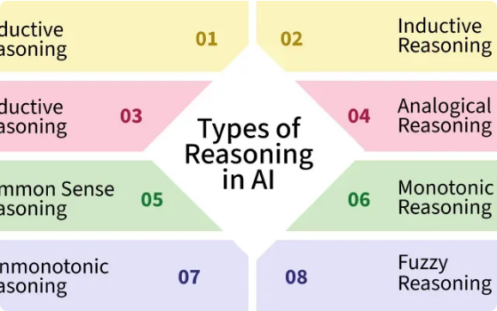
P2: Direct Reasoning & SQL Generation
SQLGlot Limitation: Valid syntax parsing does not guarantee a SELECT query. Normalizer now enforces exp.Query roots.
Schema Integrity: JSON Schema was being rendered as Python dicts, destabilizing generation. Fixed by explicit JSON serialization.
Latency Control: Qwen thinking phase breached budgets (95.6s). Fixed by setting think=false and context capping (20.2s).
Evaluation Integrity: All return paths now record total latency to prevent taxonomy skew.

Slide 6
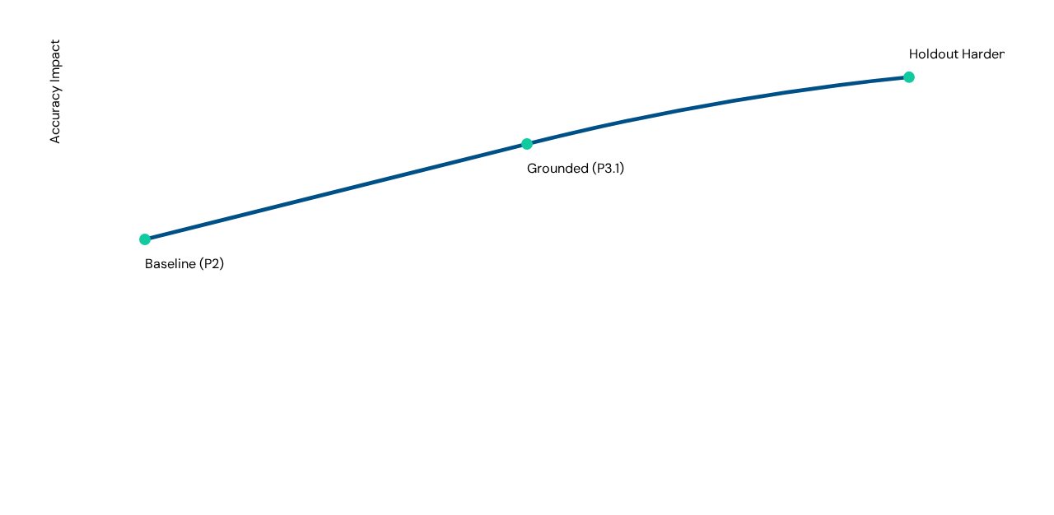

P3-P3.1: The Retrieval Evolution
Lessons in Latency
Hybrid RRF Rejected
Retrieval reporting initially skipped query embedding time (~5s/query). E2E Grounding now includes warm rank/link metrics.
BM25-heavy configs underperformed. Equal-weight RRF proved superior for qualified schema recall on disjoint holdouts.

Slide 7






P4: From Execution to Correctness
The Answer Fallacy
Stochastic Recovery
Model Variance
Execution success does not equal correctness. Introduced VALID / SUSPICIOUS / FAILED shape validators for gold-blind rules.
Repeated-SQL fingerprints now stop infinite loops. One LLM correction call is default, ensuring a "frozen run" recovers 3/4 failures.
OPEN ISSUE: Diagnostic reruns only recovered 1/3 of repair triggers. Results are model-dependent and stochastic.

Slide 8
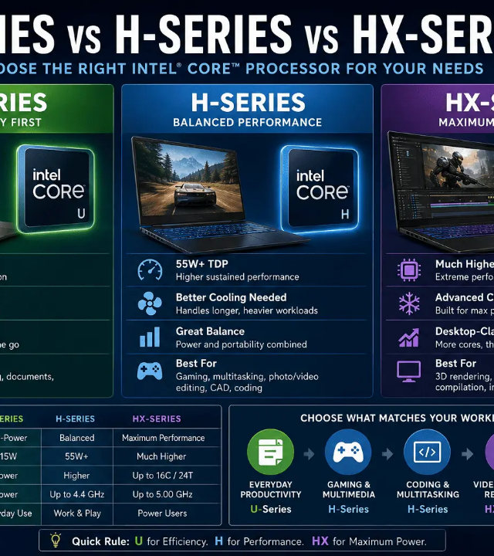
Hardware Stress & Guarding
The Incident: Continuous full-GPU benchmarks caused laptop thermal instability and power crashes.
The Response:
Power Supervisor: Samples at 0.5s; kills process groups if >115W detected.
6-Layer Profile: High-layer profiles (10-14) rejected due to 139W transients. 6-layer balance achieved.
Isolation: CPU affinity and context capping (4096) to prevent RAM/Swap overflow.
"Safety segments maintain 60–61°C, Swap 0."

Slide 9
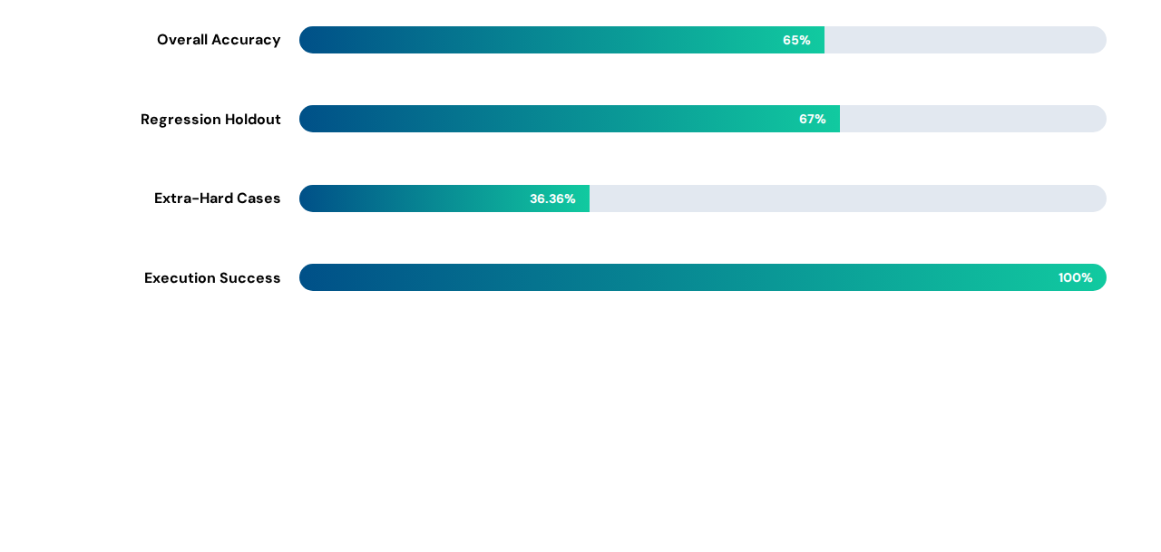

P6: Release Benchmarks & Accuracy
Strategic Bottleneck
Failures are primarily semantic mismatches for complex nested/aggregate queries, not system crashes. p95 latency remains at ~85s per query.

Slide 10



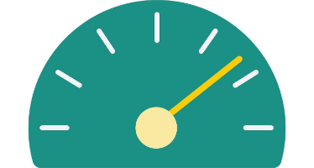

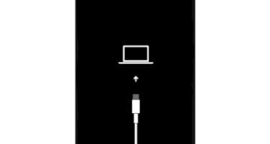
P6.2-P6.3: Schema Coherence & UI Speed
Schema Coherence: Prompting now enforces exact ownership for disconnected aggregate views vs raw tables.
UI Latency: Async polling and lazy results reduced History render from 24s to 0.05s.
Scalar Recovery: Correctors now force subquery wrapping to ensure single-row outputs for scalar intents.

Slide 11

Current Research & Accuracy Boundaries
OPEN: Latency & Semantics
Local inference on Qwen-14B remains a major bottleneck (70–100s/query). Semantic generation for complex aggregate queries remains at a 36% ceiling for "Extra-Hard" categories.
No Free-Form Accuracy
Safety Limitations
We cannot claim per-query accuracy for user-free text without gold references. UX now focuses on "Model Confidence" and validation status.
The local application is not hardened for public internet (no multi-user isolation or TLS). It remains bound to loopback for security.

Slide 12
Engineering Hygiene: The Prevention Checklist
Read First: Consult canonical ledger and gate failure IDs before any architectural change.
Validation: Mandatory positive/negative regression tests for every semantic rule added.
Questions?
Runtime: Keep random I/O inside Linux filesystems; avoid Windows mounts for SQLite execution.
Documentation Index: docs/evidence/p0-p6_gate.md
Benchmarking: Pin all model digests, indices, and prompts before launching 100+ cases.

Slide 13





Image Sources
https://media.geeksforgeeks.org/wp-content/uploads/20250717161626331723/Types-of-Reasoning-in-AI.webp
Source: www.geeksforgeeks.org
https://refurbo.in/_next/image?url=https%3A%2F%2Frefurbo.in%2Fblogs%2Fcontent%2Fimages%2F2026%2F05%2FChatGPT-Image-May-27--2026--12_32_28-PM--1-.png&w=1920&q=75
Source: refurbo.in
https://static.vecteezy.com/system/resources/previews/005/568/880/non_2x/optimization-icon-in-trendy-two-tone-style-isolated-on-soft-blue-background-free-vector.jpg
Source: www.vecteezy.com
https://static.vecteezy.com/system/resources/previews/071/274/138/non_2x/speedometer-or-gauge-icon-for-performance-and-speed-measurement-simple-flat-illustration-for-a-dashboard-or-analytics-report-vector.jpg
Source: www.vecteezy.com
http://icrack.co.uk/cdn/shop/products/iPhone13Pro_SoftwareRecoveryRepair.webp?v=1680864398
Source: icrack.co.uk

